Slide 1
Pytest and Coverage.py
Sechang Jang
SoC KAIST

Slide 2
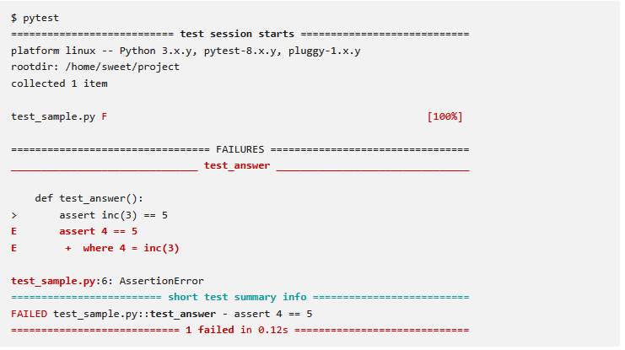
Pytest
A simple, powerful, and modern testing framework for Python.
  https://docs.pytest.org/en/stable/
  https://pypi.org/project/pytest/
Image from https://docs.pytest.org/en/stable/

Slide 3
Getting Started
0. Use python 3.14 or higher version
1. Install it:
  pip install pytest
2. How pytest Finds Tests:
  File Names: test_*.py or *_test.py
  Function Names: def test_...():
3. How to Run it:
  Type pytest in your terminal on project root directory.
  It will automatically find and run all your tests.

Slide 4
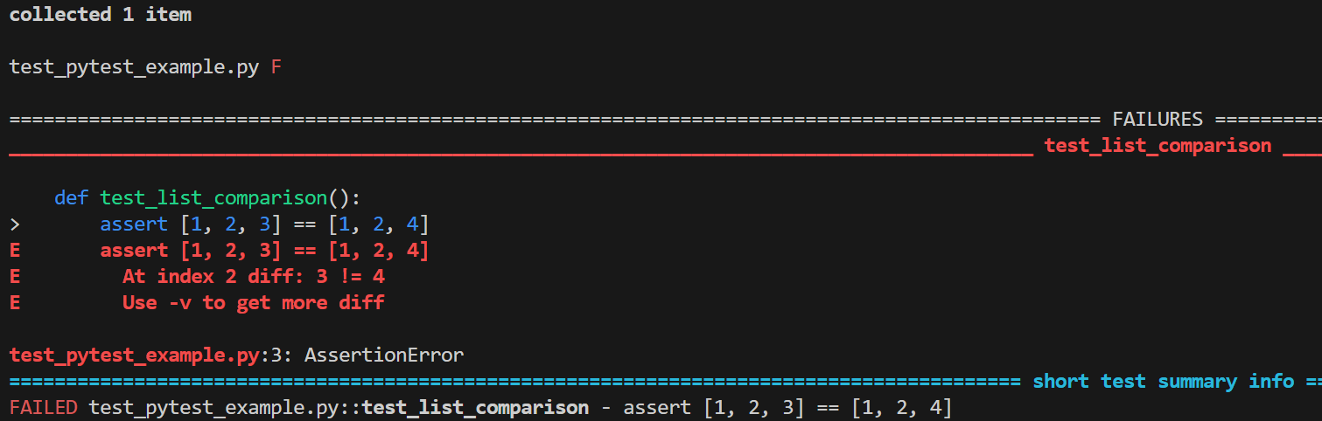
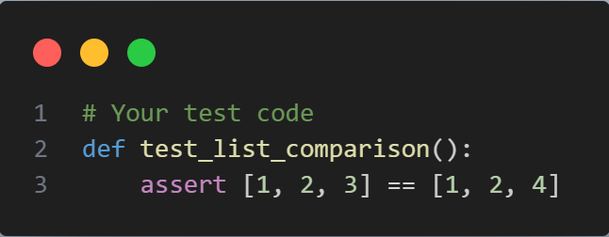
Example
test_pytest_example.py
pytest result

Slide 5
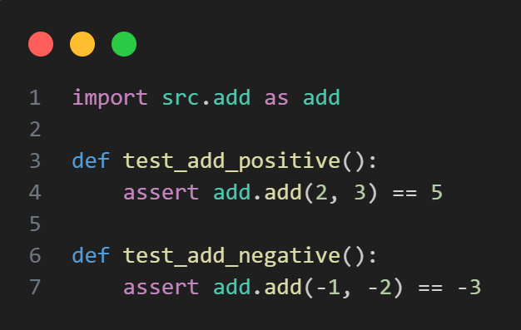
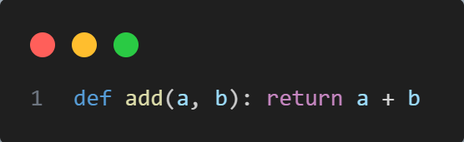
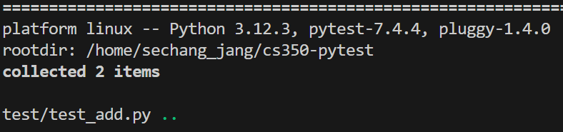
Example
Source Code
Test Code
Pytest Result

Slide 6
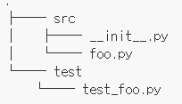
Tips
Pytest might raise “module not found error” in such scenario
  A. Create __init__.py file in a directory where test_*.py is located
  B. Or Run “python -m pytest” instead of pytest
Directory Layout

Slide 7
Coverage
Coverage.py is a tool for measuring code coverage of Python programs.
  Code Coverage: A metric that measures which lines of your source code were executed by your test suite.
  https://coverage.readthedocs.io/en/7.11.3/
  There must be test case to measure the coverage!
    Coverage.py offers integration with pytest using “-m pytest” option

Slide 8
Getting Started
0. Use python 3.14 or higher version
1. Install it:
  pip install coverage
2. Run it
  coverage run --branch -m pytest
3. See the Report
  coverage report –m
  (Show a screenshot of the terminal output: Name | Stmts | Miss | Cover | Missing)
  coverage html (or xml)
    (This creates an htmlcov/ folder. Open index.html in your browser.)

Slide 9
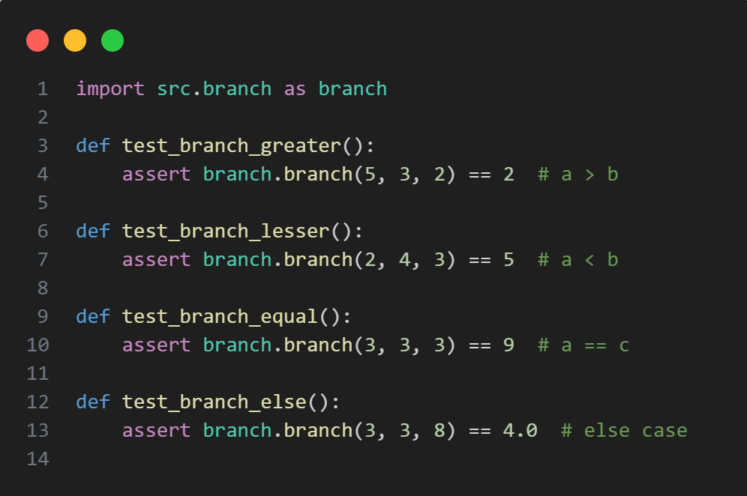
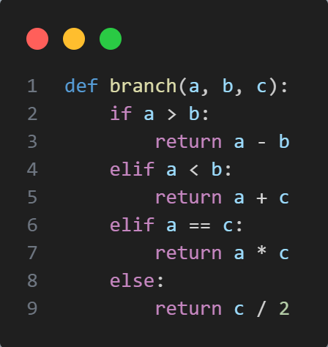
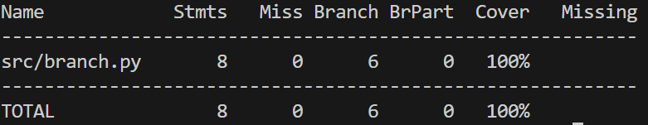
Example
Source Code
Test Code
Coverage Report

Slide 10
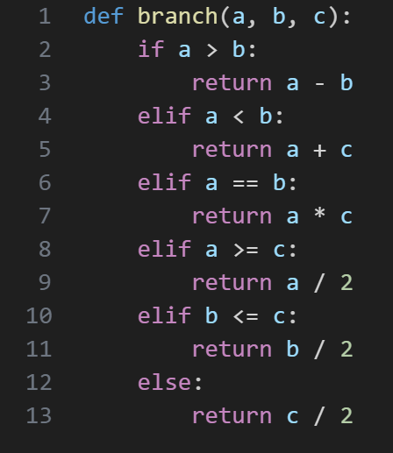
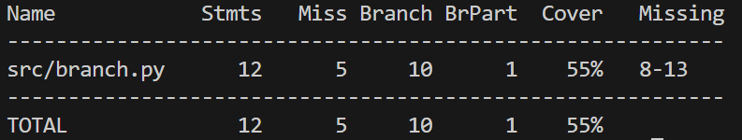
Example
Source Code
Test Code
Coverage Report

Slide 11
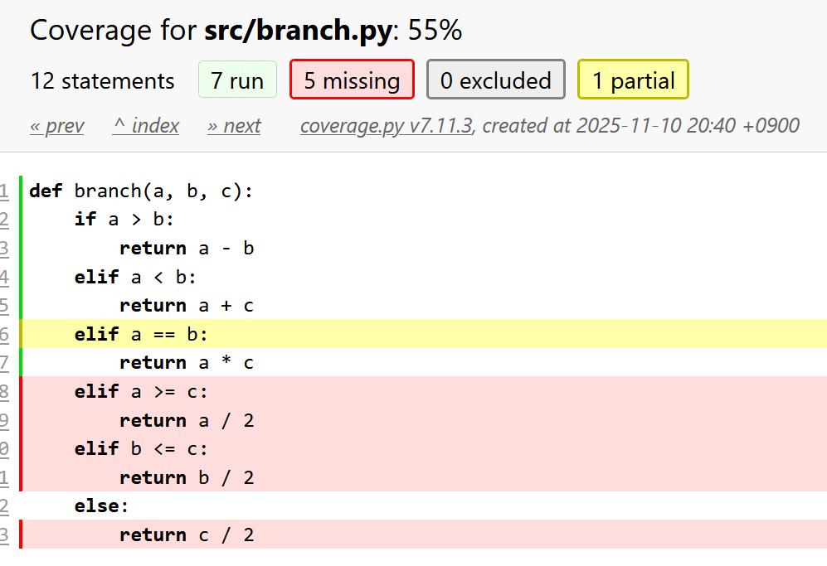
html Coverage Report

Slide 12
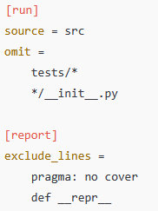
Tips
.coverage file
  It lets you control what code is measured,
  which files to ignore,
  and how reports are displayed.
  Use “exclude_lines”
  Detailed Branch coverage can be extracted using xml report
You can use pytest-cov as well!
  pytest-cov is a pytest plugin that integrates coverage.py
  integrates coverage collection into pytest seamlessly

